Slide 1



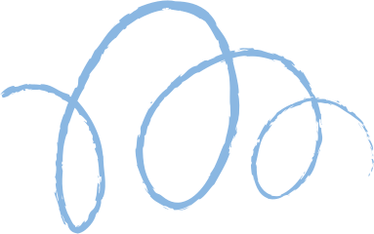









DIGITAL PORTFOLIO

Slide 2
STUDENT NAME : M.SUJASRI
REGISTER NO AND NM ID: 2426J0581 AND asbruaj2426j0581
DEPARTMENT: SCHOOL OF COMPUTER STUDIES
COLLAGE: A.V.P. COLLEGE OF ARTS AND SCIENCE

Slide 3
01.
DIGITAL PORTFOLIO
USING FRONTEND
DEVELOPMENT
Html
02.
CSS
Javascript
03.

Slide 4
Agenda
01
02
03
04
project overview
Desingn and layouts
Problem statement
Tools and technology

Slide 5
Agenda
05
06
07
08
Results and Screenshot
Conclusion
Features and Functionality
Github Link

Slide 6
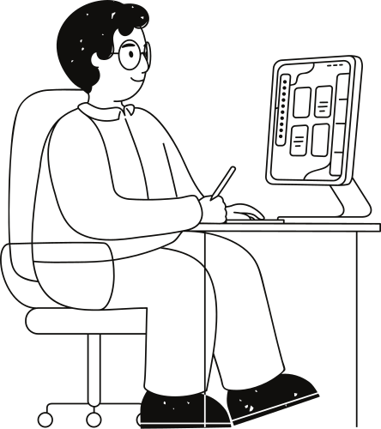
Problem statement
In today's digital era, a traditienal paper-based resume is ne lenger sufficient te shewcase ene's prefessional skills, academic achievements, and persenal prejects. Recruiters and erganizaliens seek interactive, visually appealing, and easily accessible platferms te evaluate a candidate's profile. Therefore, there is a need to design and develop a Digital Portfelic Website that effectively highlights an individual's educational background, technical expertise, prefect werk, certifications, and extracurricular achievements. This pertfelie sheuld not enty ad as a medern alternative to a resume but alse serve as a persenal branding feel that can be shared glebally. The solution must integrate HIML, CSS, and Java Script to ensure respensiveness, interadivity, and user-friendly navigatien while maintaining a prefessional leok and feel

Slide 7
Project overview
This project fecuses on developing a Digital Pertfelic Website that showcases an individual's academic qualifications, technical skills, projects, and achievements in an interadive and visually appealing fermat. The pertfelie is built using HIML, CSS, and JavaScript, ensuring respensive design and smooth navigalien acress devices.
The pertfelic serves as a modern alternative te traditional resumes, enabling recruiters, peers, and menters le easily access and evaluate the individual's prelile. It highlights key sections such as About Me, Education, Skills, Projects, Certifications, and Contact Information, providing a complete professional everview. The prefect emphasizes user experience, accessibility, and persenal branding, making it an essential feel fer career growth in the chosen field.

Slide 8
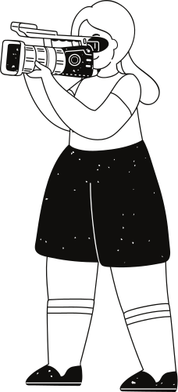
1. Development tools
2. Design Tools
HTML 5 -To structure the content of this portfolio
CSSS-Fer styling, layout design, and responsiveness.
JavaScript (E36)-Je add interativity, animatiens, and ferm validatiens. Code Editer (VS Code / Sublime Text) Ferellicient ceding and debuggin
Figma/Canva-Fer designing UI/UX meckups and layout planning. Feut Awesome/Geegle Fonts-Fer icons and typography Coler Palettes (Ceelers / Adobe Celer) - To select a professional celer scheme.
Cat & Cil Rub-Fer version centrel and code collaberalien.
Netlity/GitHub Pages / Vercel-Te hest and deploy the digital pertfelie entin
e.
Version control
Technology
Respensive Web Design (RIPD)-Fe ensure the perffetie werks en mobile, tablet, and deshtep, SEC Optimization-Je make the portfelie easily discoverable by recruiters online. Interactive Navigation-Smeeth serelling, hever effects, and dickable preject links. Minimalist & Professional Design-Feeus en readability, user experience, and branding.
Tools and Technologies

Slide 9
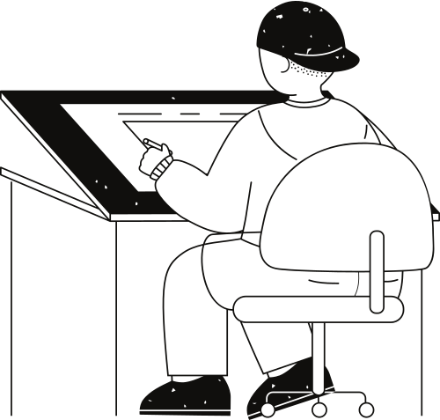
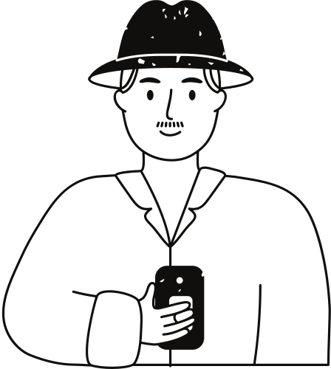

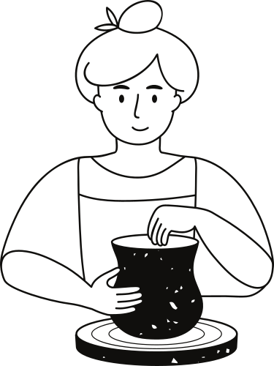


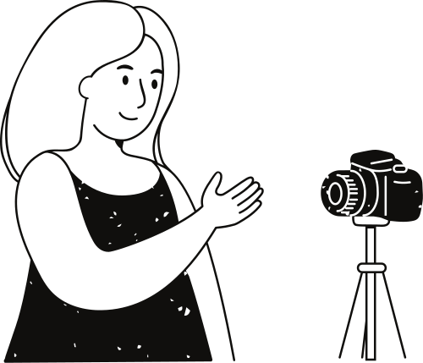
1. Home/Landing Page
A professional welcome banner with your name, title leg... "Aspiring Seltware Engineer", and a background image/animalien.
A shert tagline (e.g., Puzzieonte abent eeding, prehlem selring, and innevalien
5. Prefects
Cridfeard layout with screenshets, prejet titles, thert descriptions, and GitHub/deme links. Example: "Library Management System-Java, MySOL"
Design & Layout
2. Abeat Me Secdien:A professional phele.A shert bie highlighting your academic back grennd and Cuick inte (email, fecation, LinkedIn, GitHub).
3. Education:Dimeline style layout shewing degrees, institutions, and year of completion.
6. Certifications & Achievements
Certificates displayed in a carensel er grid vieu Achievement's listed with icons,
4. Skills
Displayed as skill bars, icens, er badges (eg., C, Java Python, RIML, CSS, Java Script, DRMS) Could include sell shifts (tenmuerk, problem-solving).
7. Contact Section
A simple contact ferm (name, email, message). Secial media/Linked In/Cit Rubelickable icens.
8. Feeler
Copyright Your Name Quick navigation
links

Slide 10
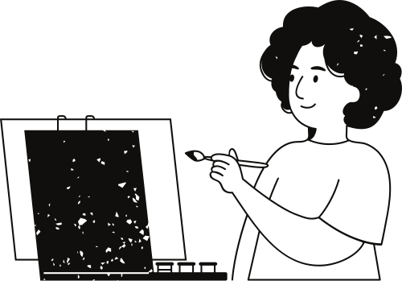
Features and Functionality
.1 Responsible design -work in all devices
2. Interactive Navigation - Smooth serelling, hever effects, and quick access menu. 3. About Me Section - Displays bie, academic background, and career geals.
4. Skills Shewcase Visual representation of technical and sell skills (bars, badges,)
5. Projects Callery-Cards/grid layout with project details, GitHub/deme links.
6. Certifications & Achievements Display el certificates, awards, er recognitions.
7. Centad Ferm Allews recruiters le send messages directly.
8. Secial Media & GitHub Integration - Quick links for prefessional netwerking.
9. Deunlead Resume Option Bulten to dewnload your CV in PDF format.
10. SEO Optimized Pertfelie - Easy to discover enline fer recruiters.

Slide 11
Result and Screenshot
The Digital Pertfelie successfully prevides an interactive platform to showcase your academic qualifications, technical skills, prefects, certifications, and achievements in a professional and vimally appealing way. It enhances your prsenal branding, acts as an entine resume, and makes it easier fer recruiters, peers, and menters te access your profile. The portfelie is respensive, user-friendly, and highlights your field-specific expertise in Computer Science/II.
Academic Project

Slide 12
conclusion
The Digital Portfolio serves as a modern, interactive platform to showcase academic achievements, technical skills, and project work in the field of Computer Science. It goes beyond a traditional resume by providing recruiters and mentors with an engaging, accessible, and professional overview of one's capabilities. By integraling responsive design, project highlights, and certifications, the portfolio strengthens personal branding and enhances career opportunities in the II domain.

Slide 13
Thank you very much!

